Slide 1
What can we find from RREF?
Hung-yi Lee
Notes:
Estimated P15

Slide 2
Outline
RREF v.s. Linear Combination
RREF v.s. Independent
RREF v.s. Rank
RREF v.s. Span

Slide 3
What can we find from RREF?
RREF v.s. Linear Combination

Slide 4

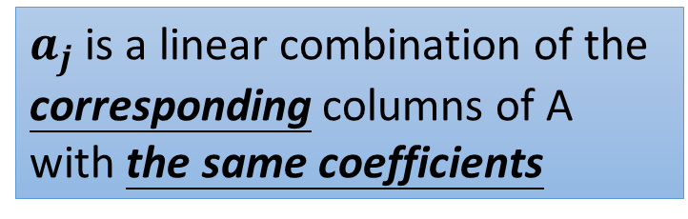

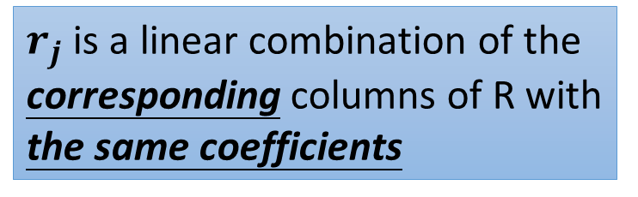
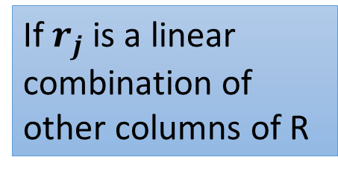
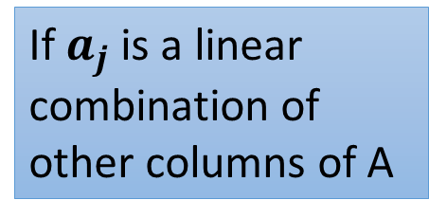
Column Correspondence Theorem
RREF
$$A=\left[\begin{matrix}a_{1} & ⋯ & a_{n}\end{matrix}\right]$$
$$R=\left[\begin{matrix}r_{1} & ⋯ & r_{n}\end{matrix}\right]$$
If $a_{j}$ is a linear combination of other columns of A
$r_{j}$ is a linear combination of the corresponding columns of R with the same coefficients
a₅ = −a₁+a₄
r₅ = −r₁+r₄
$a_{j}$ is a linear combination of the corresponding columns of A with the same coefficients
If $r_{j}$ is a linear combination of other columns of R
a₃ = 3a₁-2a₂
r₃ = 3r₁-2r₂

Slide 5
Column Correspondence Theorem - Example
a₁
a₂
a₃
a₄
a₅
a₆
r₁
r₂
r₃
r₄
r₅
r₆
a₂ = 2a₁
r₂ = 2r₁
a₅ = −a₁+a₄
r₅ = −r₁+r₄
Notes:
P118 – 122 (Chapter 2.3)

Slide 6

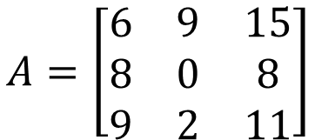
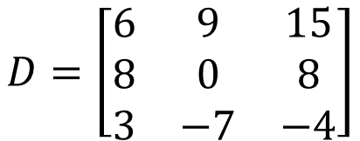
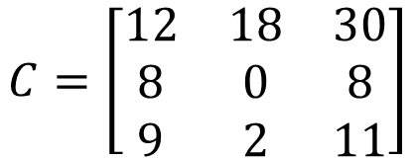
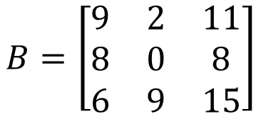



Column Correspondence Theorem – Intuitive Reason
$$a_{1}+a_{2}=a_{3}$$
$$A=\left[\begin{matrix}6 & 9 & 15 \\ 8 & 0 & 8 \\ 9 & 2 & 11\end{matrix}\right]$$
$$d_{1}+d_{2}=d_{3}$$
$$b_{1}+b_{2}=b_{3}$$
$$D=\left[\begin{matrix}6 & 9 & 15 \\ 8 & 0 & 8 \\ 3 & −7 & −4\end{matrix}\right]$$
$$B=\left[\begin{matrix}9 & 2 & 11 \\ 8 & 0 & 8 \\ 6 & 9 & 15\end{matrix}\right]$$
$$c_{1}+c_{2}=c_{3}$$
$$C=\left[\begin{matrix}12 & 18 & 30 \\ 8 & 0 & 8 \\ 9 & 2 & 11\end{matrix}\right]$$
Column Correspondence Theorem (Column 間的愛)：
就算 row elementary operation 讓 column 變的不同，他們之間的關係永遠不變。

Slide 7
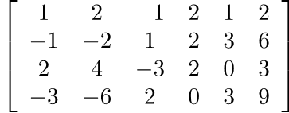
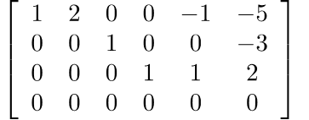






Column Correspondence Theorem – More Formal Reason
Before we start:
RREF
Augmented Matrix:
$$\left[\begin{matrix}A & b\end{matrix}\right]$$
$$\left[\begin{matrix}R & b\end{matrix}′\right]$$
RREF
Coefficient Matrix:
$$A$$
$$R$$
$$\left[\begin{matrix}A & b\end{matrix}\right]$$
$$\left[\begin{matrix}R & b′\end{matrix}\right]$$

Slide 8


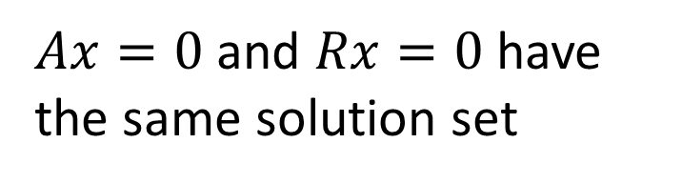

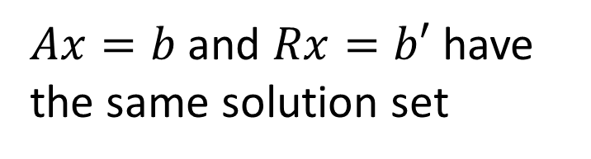
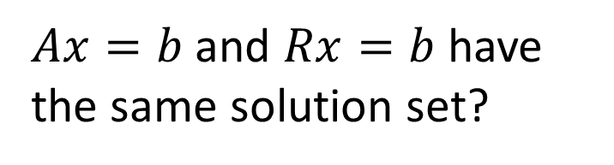

Column Correspondence Theorem – More Formal Reason
The RREF of matrix A is R
The RREF of augmented matrix $\left[\begin{matrix}A & b\end{matrix}\right]$ is $\left[\begin{matrix}R & b′\end{matrix}\right]$
The RREF of matrix A is R
$Ax=b$ and $Rx=b$ have the same solution set?
$Ax=b$ and $Rx=b′$ have the same solution set
$Ax=0$ and $Rx=0$ have the same solution set
If $b=0$, then $b′=0$.
Notes:
P120

Slide 9





Column Correspondence Theorem
The RREF of matrix A is R, $Ax=0$ and $Rx=0$ have the same solution set
a₁
a₂
a₃
a₄
a₅
a₆
r₁
r₂
r₃
r₄
r₅
r₆
a₂ = 2a₁
$$x=\left[\begin{matrix}\begin{matrix}−2 \\ 1 \\ 0\end{matrix} \\ \begin{matrix}0 \\ 0 \\ 0\end{matrix}\end{matrix}\right]$$
$$x=\left[\begin{matrix}\begin{matrix}−2 \\ 1 \\ 0\end{matrix} \\ \begin{matrix}0 \\ 0 \\ 0\end{matrix}\end{matrix}\right]$$
r₂ = 2r₁
$$Ax=0$$
$$Rx=0$$
-2a₁+a₂=0
-2r₁+r₂=0

Slide 10


Column Correspondence Theorem
The RREF of matrix A is R, $Ax=0$ and $Rx=0$ have the same solution set
a₁
a₂
a₃
a₄
a₅
a₆
r₁
r₂
r₃
r₄
r₅
r₆
a₅ = −a₁+a₄
$$x=\left[\begin{matrix}\begin{matrix}1 \\ 0 \\ 0\end{matrix} \\ \begin{matrix}−1 \\ 1 \\ 0\end{matrix}\end{matrix}\right]$$
$$x=\left[\begin{matrix}\begin{matrix}1 \\ 0 \\ 0\end{matrix} \\ \begin{matrix}−1 \\ 1 \\ 0\end{matrix}\end{matrix}\right]$$
r₅ = −r₁+r₄
$$Ax=0$$
$$Rx=0$$
a₁-a₄+a₅=0
r₁-r₄+r₅=0

Slide 11
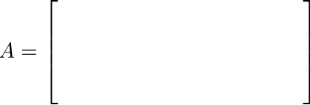
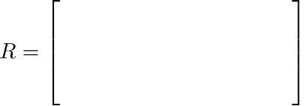










How about Rows?
NO
Are there row correspondence theorem?
$$a_{1}^{T}$$
$$r_{1}^{T}$$
$$a_{2}^{T}$$
$$r_{2}^{T}$$
$$a_{3}^{T}$$
$$r_{3}^{T}$$
$$a_{4}^{T}$$
$$r_{4}^{T}$$
$$Span\left\{a_{1},a_{2},a_{3},a_{4}\right\}$$
=
$$Span\left\{r_{1},r_{2},r_{3},r_{4}\right\}$$
Are they the same?

Slide 12




Span of Columns
$$A=\left[\begin{matrix}a_{1} & ⋯ & a_{6}\end{matrix}\right]$$
$$R=\left[\begin{matrix}r_{1} & ⋯ & r_{6}\end{matrix}\right]$$
$$Span \left\{\begin{matrix}a_{1}, & ⋯ & ,a_{6}\end{matrix}\right\}$$
$$Span \left\{\begin{matrix}r_{1}, & ⋯ & ,r_{6}\end{matrix}\right\}$$
Are they the same?
The elementary row operations change the span of columns.

Slide 13
NOTE
Original Matrix v.s. RREF
  Columns:
    The relations between the columns are the same.
    The span of the columns are different.
  Rows:
    The relations between the rows are changed.
    The span of the rows are the same.

Slide 14
What can we find from RREF?
RREF v.s. Independent
Notes:
從 RREF 一眼看出 rank

Slide 15
Column Correspondence Theorem
pivot columns
Leading entries
linear independent
linear independent
The pivot columns are linear independent.

Slide 16
Column Correspondence Theorem
You can prove unique RREF by these properties
pivot columns
Leading entries
a₂ = 2a₁
a₅ = −a₁+a₄
a₆ = −5a₁−3a₃+2a₄
r₂ = 2r₁
r₅ = −r₁+r₄
r₆ = −5r₁−3r₃+2r₄
The non-pivot columns are the linear combination of the previous pivot columns.

Slide 17
Column Correspondence Theorem
Given the pivot columns of a matrix and its RREF, we can reconstruct the whole matrix.
pivot columns
a₁
a₃
a₄
a₂ = 2a₁
r₂ = 2r₁
a₅ = −a₁+a₄
r₅ = −r₁+r₄
a₆ = −5a₁−3a₃+2a₄
r₆ = −5r₁−3r₃+2r₄
Notes:
You can prove unique RREF by these properties

Slide 18
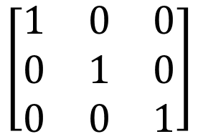
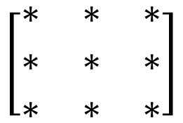
Independent
3X3
The columns are independent
$$\left[\begin{matrix}∗ & ∗ & ∗ \\ ∗ & ∗ & ∗ \\ ∗ & ∗ & ∗\end{matrix}\right]$$
Columns are linear independent
Every column is a pivot columns
RREF
Every column in RREF(A) is standard vector.
$$\left[\begin{matrix}1 & 0 & 0 \\ 0 & 1 & 0 \\ 0 & 0 & 1\end{matrix}\right]$$
Identity matrix

Slide 19

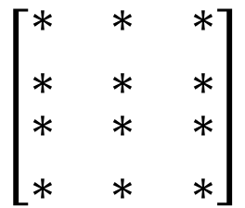
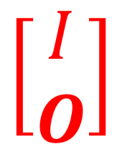
Independent
4X3
$$\left[\begin{matrix}\begin{matrix}∗ & ∗ & ∗ \\ ∗ & ∗ & ∗\end{matrix} \\ \begin{matrix}∗ & ∗ & ∗ \\ ∗ & ∗ & ∗\end{matrix}\end{matrix}\right]$$
The columns are independent
Columns are linear independent
Every column is a pivot columns
RREF
Every column in RREF(A) is standard vector.
$$\left[\begin{matrix}\begin{matrix}1 & 0 & 0 \\ 0 & 1 & 0\end{matrix} \\ \begin{matrix}0 & 0 & 1 \\ 0 & 0 & 0\end{matrix}\end{matrix}\right]$$
$$\left[\begin{matrix}I \\ O\end{matrix}\right]$$

Slide 20
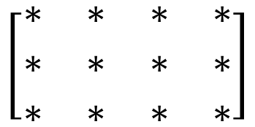

Independent
3X4
The columns are independent
$$\left[\begin{matrix}\begin{matrix}∗ & ∗ \\ ∗ & ∗ \\ ∗ & ∗\end{matrix} & \begin{matrix}∗ & ∗ \\ ∗ & ∗ \\ ∗ & ∗\end{matrix}\end{matrix}\right]$$
Columns are linear independent
Every column is a pivot columns
RREF
Cannot be a pivot column
Every column in RREF(A) is standard vector.
$$\left[\begin{matrix}\begin{matrix}1 & 0 \\ 0 & 1 \\ 0 & 0\end{matrix} & \begin{matrix}0 & ∗ \\ 0 & ∗ \\ 1 & ∗\end{matrix}\end{matrix}\right]$$

Slide 21

Independent
$$\left[\begin{matrix}\begin{matrix}∗ & ∗ \\ ∗ & ∗ \\ ∗ & ∗\end{matrix} & \begin{matrix}∗ & ∗ \\ ∗ & ∗ \\ ∗ & ∗\end{matrix}\end{matrix}\right]$$
The columns are dependent
(矮胖型)
Dependent or Independent?
More than 3 vectors in R³ must be dependent.
More than m vectors in R^{m} must be dependent.

Slide 22
What can we find from RREF?
RREF v.s. Rank
Notes:
從 RREF 一眼看出 rank

Slide 23


Rank
Pivot column
Leading Entry
Non-zero row
Maximum number of Independent Columns
$$=$$
3
Rank = ?
Number of Pivot Column
$$=$$
Number of Non-zero rows
Rank = ?
3

Slide 24


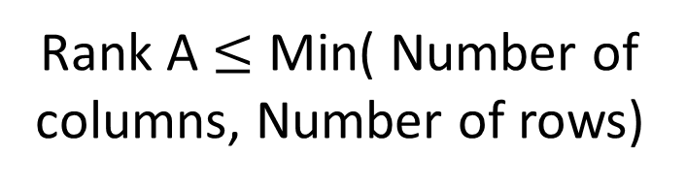
Properties of Rank from RREF
Maximum number of Independent Columns
Rank A $≤$ Number of columns
$$=$$
Number of Pivot Column
Rank A $≤$ Min( Number of columns, Number of rows)
$$=$$
Number of Non-zero rows
Rank A $≤$ Number of rows

Slide 25
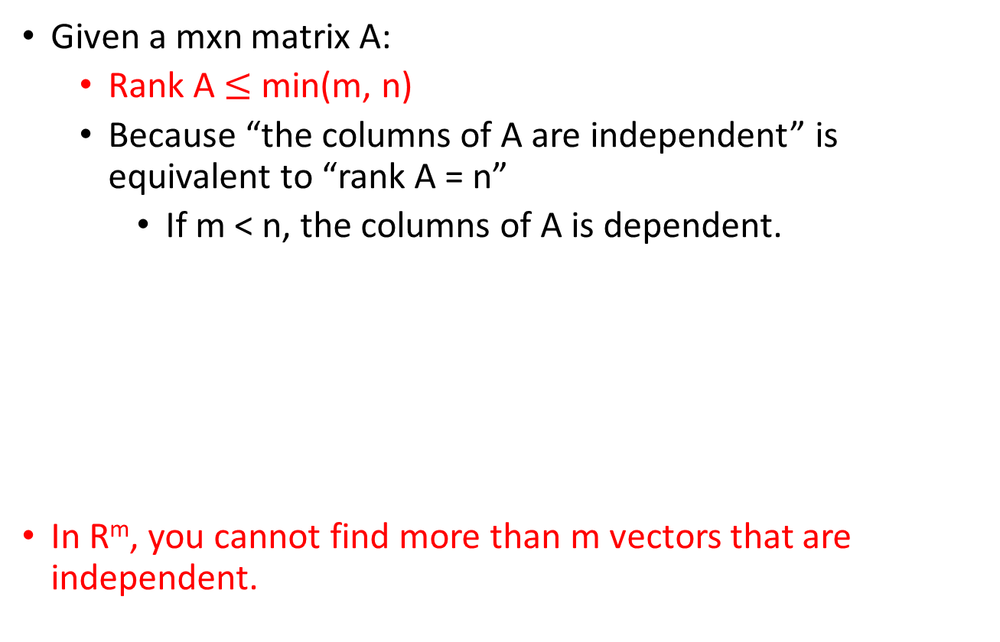

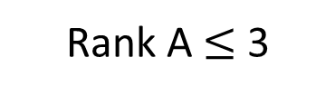

Properties of Rank from RREF
Matrix A is full rank if Rank A = min(m,n)
Given a mxn matrix A:
  Rank A $≤$ min(m, n)
  Because “the columns of A are independent” is equivalent to “rank A = n”
    If m < n, the columns of A is dependent.
In R^{m}, you cannot find more than m vectors that are independent.
$$\left[\begin{matrix}\begin{matrix}∗ & ∗\end{matrix} & \begin{matrix}∗ & ∗\end{matrix} \\ \begin{matrix}∗ & ∗\end{matrix} & \begin{matrix}∗ & ∗\end{matrix} \\ \begin{matrix}∗ & ∗\end{matrix} & \begin{matrix}∗ & ∗\end{matrix}\end{matrix}\right]$$
$$\left\{\left[\begin{matrix}∗ \\ ∗ \\ ∗\end{matrix}\right],\left[\begin{matrix}∗ \\ ∗ \\ ∗\end{matrix}\right],\left[\begin{matrix}∗ \\ ∗ \\ ∗\end{matrix}\right],\left[\begin{matrix}∗ \\ ∗ \\ ∗\end{matrix}\right]\right\}$$
3 X 4
A matrix set has 4 vectors belonging to R³ is dependent
Rank A $≤$ 3
Notes:
未看先猜

Slide 26


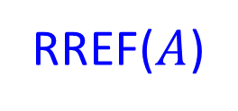


Basic, Free Variables v.s. Rank
3 useful
equations
$$Ax=b$$
$$A$$
$$b$$
RREF($A$)
$$b’$$
rank
=
non-zero row
=
3 basic variables
No. column –non-zero row
nullity
=
=
2 free variables
Notes:
The rank of [A b] is the number of “useful” equations in the system of linear equations Ax = b (i.e., the number of nonzero rows in [R c]).
The rank of A represents the number of basic variables while the nullity of A is the number of free variables.

Slide 27
Rank
Rank
Maximum number of Independent Columns
Number of Pivot Column
Number of Non-zero rows
Number of Basic Variables
Nullity = no. column - rank
Number of zero rows
Number of Free Equations

Slide 28
What can we find from RREF?
RREF v.s. Span
Notes:
從 RREF 一眼看出 rank

Slide 29

Consistent or not
Given Ax=b, if the reduced row echelon form of [ A b ] is
Given Ax=b, if the reduced row echelon form of [ A b ] is
Consistent
b is in the span of the columns of A
inconsistent
b is NOT in the span of the columns of A
$$0∙x_{1}+0∙x_{2}+0∙x_{3}=1$$

Slide 30



Consistent or not
Ax =b is inconsistent (no solution)
The RREF of [A b] is
$$\left[\begin{matrix}\begin{matrix}∗ & ∗ & ∗ \\ ∗ & ∗ & ∗ \\ ∗ & ∗ & ∗\end{matrix} & \begin{matrix}∗ & ∗ & ∗ \\ ∗ & ∗ & ∗ \\ ∗ & ∗ & ∗\end{matrix} \\ \begin{matrix}0 & 0 & 0 \\ 0 & 0 & 0 \\ 0 & 0 & 0\end{matrix} & \begin{matrix}0 & 0 & d \\ 0 & 0 & 0 \\ 0 & 0 & 0\end{matrix}\end{matrix}\right]$$
Only the last column is non-zero
$$d≠0$$
Rank A $≠$ rank [A b]
Need to know b

Slide 31
Consistent or not
Ax =b is consistent for every b
RREF of [A b] cannot have a row whose only non-zero entry is at the last column
RREF of A cannot have zero row
Rank A = no. of rows

Slide 32

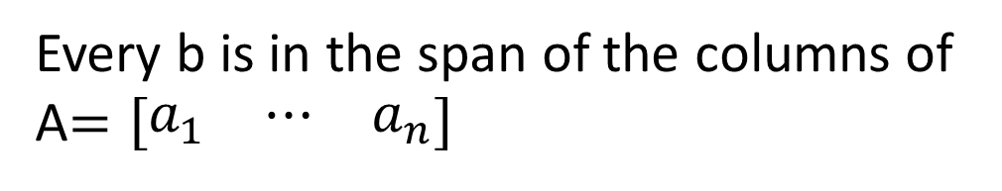


Consistent or not
e.g.
$$\left[\begin{matrix}\begin{matrix}∗ & ∗\end{matrix} & \begin{matrix}∗ & ∗\end{matrix} \\ \begin{matrix}∗ & ∗\end{matrix} & \begin{matrix}∗ & ∗\end{matrix} \\ \begin{matrix}∗ & ∗\end{matrix} & \begin{matrix}∗ & ∗\end{matrix}\end{matrix}\right]$$
3 independent columns
Ax =b is consistent for every b
Rank A = no. of rows
Every b is in the span of the columns of A$=\left[\begin{matrix}a_{1} & ⋯ & a_{n}\end{matrix}\right]$
Every b belongs to $Span\left\{\begin{matrix}a_{1}, & ⋯ & ,a_{n}\end{matrix}\right\}$
$Span\left\{\begin{matrix}a_{1}, & ⋯ & ,a_{n}\end{matrix}\right\}=R^{m}$
m independent vectors can span $R^{m}$
More than m vectors in R^{m} must be dependent.

Slide 33


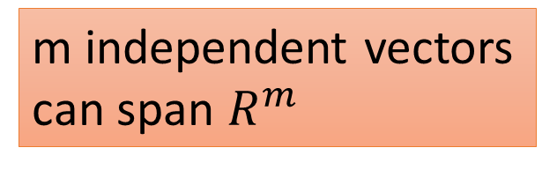

m independent vectors can span $R^{m}$
More than m vectors in R^{m} must be dependent.
$$a$$
Consider R²
$$b$$
$$c$$
yes
independent

Slide 34


Full Rank: Rank = n & Rank = m
1
0
$$\left[\begin{matrix}\begin{matrix}∗ & ∗ & ∗ \\ ∗ & ∗ & ∗ \\ ⋮ & ⋮ & ⋮\end{matrix} & \begin{matrix}∗ & ∗ & ∗ \\ ∗ & ∗ & ∗ \\ ⋮ & ⋮ & ⋮\end{matrix} \\ \begin{matrix}⋮ & ⋮ & ⋮ \\ ∗ & ∗ & ∗ \\ ∗ & ∗ & ∗\end{matrix} & \begin{matrix}⋮ & ⋮ & ⋮ \\ ∗ & ∗ & ∗ \\ ∗ & ∗ & ∗\end{matrix}\end{matrix}\right]$$
The size of A is mxn
0
1
Rank A = n
A is square or 高瘦
0
0
0
0
Ax = b has at most one solution
The columns of A are linearly independent.
$$\left[\begin{matrix}I \\ O\end{matrix}\right]$$
All columns are pivot columns.
RREF of A:

Slide 35
Full Rank: Rank = n & Rank = m
1
$$\left[\begin{matrix}\begin{matrix}∗ & ∗ & ∗ \\ ∗ & ∗ & ∗ \\ ⋮ & ⋮ & ⋮\end{matrix} & \begin{matrix}∗ & ∗ & ∗ \\ ∗ & ∗ & ∗ \\ ⋮ & ⋮ & ⋮\end{matrix} \\ \begin{matrix}⋮ & ⋮ & ⋮ \\ ∗ & ∗ & ∗ \\ ∗ & ∗ & ∗\end{matrix} & \begin{matrix}⋮ & ⋮ & ⋮ \\ ∗ & ∗ & ∗ \\ ∗ & ∗ & ∗\end{matrix}\end{matrix}\right]$$
The size of A is mxn
0
1
Rank A = m
A is square or 矮胖
0
0
0
1
0
0
0
0
1
Every row of R contains a pivot position (leading entry).
Ax = b always have solution (at least one solution) for every b in R^{m}.
The columns of A generate R^{m}.

Slide 36
Acknowledgement
感謝 同學發現投影片上的錯誤 (RREF)
感謝 劉俊廷 同學發現投影片上的錯誤
Notes:
Non-zero

